Slide 1

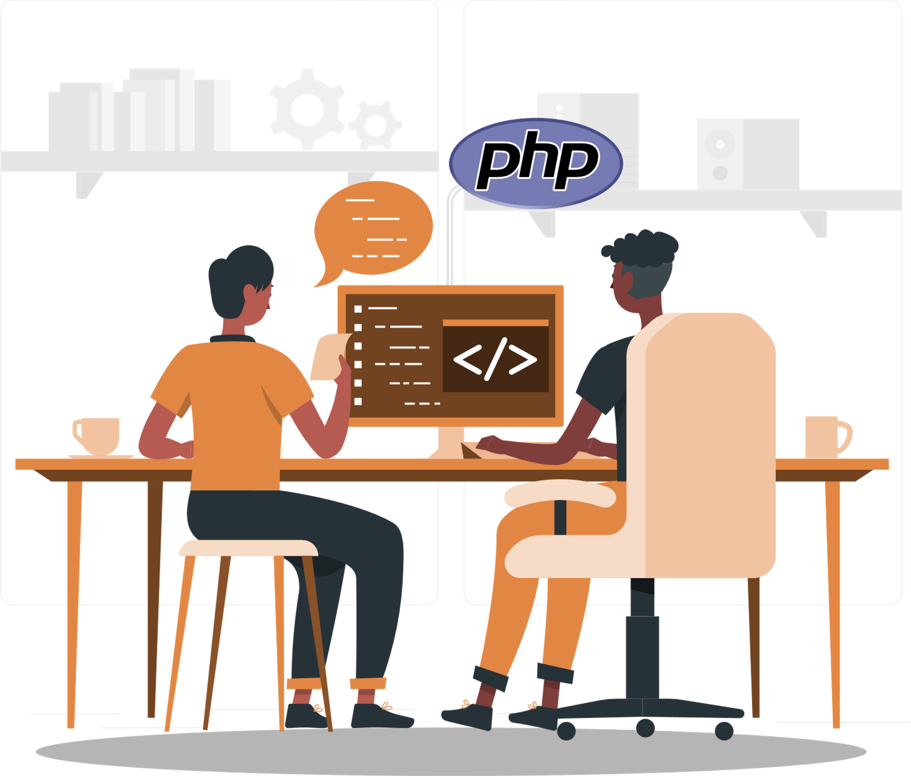
What You Need to Know Before Hiring Dedicated PHP Programmers

Slide 2
PHP is a scripting language that many developers love because of its convenience and wide range of applications. There are many PHP developers out there, but it can be tough to find the best ones. You may locate and hire the greatest ones with the help of the following advice.
Source: https://www.weblineglobal.com/blog/guide-to-hire-dedicated-php-programmers/

Slide 3
Why Hire Dedicated PHP Programmers/Developers?
PHP is Fast
01
PHP applications load quickly. This is because PHP-built software products execute in their memories, which enhances loading speed.
It is Feasible
02
PHP may be used on any standard server and is even capable of handling a variety of other tasks. PHP makes it possible to do everything from simple server-side scripting to full software development.
Database Feasibility
03
PHP frameworks have incredible database connectivity. It can connect to numerous database servers, and the most frequent one is MySQL, which may be used for free in PHP.
Source: https://www.weblineglobal.com/blog/guide-to-hire-dedicated-php-programmers/

Slide 4
Why Hire Dedicated PHP Programmers/Developers?
Cost-effective Execution
04
PHP is an open-source scripting language, which implies that it’s free to use. This makes it a cost-effective tool for businesses.
High Supply
05
There are several PHP professionals with excellent qualifications, experience, and skills abound in this market. As a result, finding and hiring PHP specialists for your business is frequently easier.
Object-Oriented Nature
06
Subsequent releases of PHP after 5.0 have included object-oriented features, allowing OOP concepts and making development much more efficient.
Source: https://www.weblineglobal.com/blog/guide-to-hire-dedicated-php-programmers/

Slide 5
Hire PHP Programmers: What Should You Know?
Developer’s Role is Critical
1
You must work with a skilled PHP developer to take your concepts and make them a reality if you want your website to be successful. The amount of expertise needed for your project will vary, but in general, they should be familiar with HTML and grasp various.
2
Hiring Model Should be pre-decided
Hiring a developer hourly, part-time, or full-time are the three most common models for hire. The project’s timeline and budget will assist you in deciding which one to use.
Source: https://www.weblineglobal.com/blog/guide-to-hire-dedicated-php-programmers/

Slide 6
Hire PHP Programmers: What Should You Know?
Communication is the Key
For everything to work smoothly and effectively, there must be strong communication across all teams and departments. Hence, ensure the following:
Everyone is on the same page
Set realistic expectations
Define the project’s objectives
Have a clear understanding of what needs to be delivered
3
4
Adaptability = Improved Outcomes
PHP developer should comprehend the mission’s overall end-user needs, target markets, and technical criteria. The PHP developer should be able to think of new and different ways to manage changes in the development environment.
Source: https://www.weblineglobal.com/blog/guide-to-hire-dedicated-php-programmers/

Slide 7
Where Can You Find Freelance PHP Developers?
Hire expert PHP developers full-time by reaching out to agencies. If you’re looking for qualified leads for your business, searching LinkedIn for PHP development companies is a great place to start.
Source: https://www.weblineglobal.com/blog/guide-to-hire-dedicated-php-programmers/

Slide 8
Conclusion
The most important thing is that the PHP developer you hire should be able to adapt to your project’s changing environment. Communication skills are also important, as is the ability to work well with other team members. Lastly, ask for previous work samples to understand their capabilities.
Source: https://www.weblineglobal.com/blog/guide-to-hire-dedicated-php-programmers/

Slide 9
Thanks!
CONTACT US
+1-213-908-1090 (USA)
+61-2-8011-4668 (AUS)
+44-207-193-7507 (UK)
+91-79-26420897 (IND)
EMAIL
WEBSITE
info@weblineglobal.com
www.weblineglobal.com

