Slide 1


Hiring React Native Developers: A Step-By-Step Guide

Slide 2

Hiring a React Native developer for your project is not as simple as it may appear. The blog discusses factors to consider when hiring react native developers or react native experts from a React Native development company.
Source :https://www.weblineglobal.com/blog/hiring-react-native-developers-guide/

Slide 3
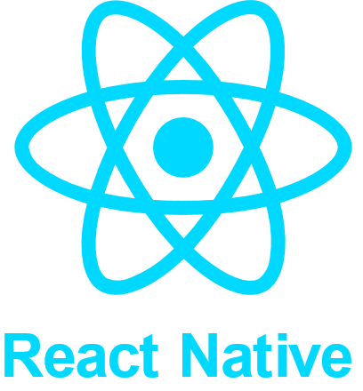
About this template
What exactly is React Native?
React Native is a JavaScript framework that enables developers to construct mobile apps for iOS and Android. React Native makes use of a combination of JavaScript and JSX, as well as XML-like mark-up.
Source :https://www.weblineglobal.com/blog/hiring-react-native-developers-guide/

Slide 4
About this template
Things to Look for When Hiring React Native Developers
How familiar are they with JavaScript?
Developers must be familiar with JavaScript and its enhanced features because React Native is built on top of it. At the explicit infrastructure levels, JavaScript allows you to create collaborating UI elements and structure application logic.
Do they have any React Native experience?
Working knowledge of React Native can be of significant advantage. A React Native development company that has successfully completed projects for clients with complex needs is a valuable asset to hire for your project.
Source :https://www.weblineglobal.com/blog/hiring-react-native-developers-guide/

Slide 5
About this template
Things to Look for When Hiring React Native Developers
Are they aware of alternative technologies?
Knowledge of related technologies, such as the ability to combine state management frameworks like Redux, provides exact control over the app logic and overall UX. Understanding the database and cloud technologies being used for the project might be of huge advantage.
Are they able to write clean code?
The primary goal is to write code that is simple to read and understand. The ability to write app code is apparent, but developers must also understand how various code types interact.
Source :https://www.weblineglobal.com/blog/hiring-react-native-developers-guide/

Slide 6
About this template
Things to Look for When Hiring React Native Developers
Do they have any experience with the iOS and Android platforms?
One advantage of the React Native framework is that it provides a single codebase for both the iOS and Android platforms, eliminating the need to create native apps individually. Hiring a react native developer will be advantageous.
Can they debug and test a program?
Application debugging and testing is a critical process that requires special attention. Every aspect of testing, such as security and performance checks, is a task that a programmer must be able to complete effectively.
Source :https://www.weblineglobal.com/blog/hiring-react-native-developers-guide/

Slide 7
About this template
Things to Look for When Hiring React Native Developers
Do they have the knowledge to improve application performance?
To achieve the best application performance, a programmer should be able to optimise performance. While no developer would intentionally impede app productivity, it is all part of their knowledge that allows them to optimise the scripts quickly.
Examine their communication and interpersonal skills
Soft skills include a React Native developer’s interactive and communication ability. It includes aspects such as problem-solving talents, leadership abilities, and decision-making abilities that are necessary for leading growth processes.
Source :https://www.weblineglobal.com/blog/hiring-react-native-developers-guide/

Slide 8
Why and When Should You Hire Dedicated React Native App Developers or a React Native Development Firm?
The most important decision is selecting the best outsourcing React Native development business or technology partner. This circumstance is because both freelancers & in-house staff face challenges. This is why companies like yours should consider outsourcing React Native development projects.
Source :https://www.weblineglobal.com/blog/hiring-react-native-developers-guide/

Slide 9
How Can We Help You on Your Cross-Platform App Development Journey?
WeblineGlobal specialises in creating unique mobile applications with improved user interfaces that focus on providing a useful user experience. Our goals are to aid you in comprehending the full potential of new technology.
Source :https://www.weblineglobal.com/blog/hiring-react-native-developers-guide/

Slide 10
About this template
Moving Forward with React Native Development
So, if you’ve decided to create a cross-platform application for your business, React Native is the perfect option because it allows you to create applications with a stunning Native user experience.
Source :https://www.weblineglobal.com/blog/hiring-react-native-developers-guide/

Slide 11
About this template
How much should React Native developers be paid?
When determining the compensation of React Native engineers, there are numerous aspects to consider. For starters, experience level is an important factor in compensation discussions. Companies, on the other hand, they can easily find a team of junior/middle-level developers who have worked on projects successfully in the past.
Source :https://www.weblineglobal.com/blog/hiring-react-native-developers-guide/

Slide 12
Why hiring React Native developers with WeblineGlobal can help?
WeblineGlobal enables businesses to employ React Native developers at the click of a button. The company has an advanced AI-powered talent cloud system that remotely sources, vets, and pairs developers. WeblineGlobal has 22+ Years of Excellence in Technology & has delivered 3500+ projects globally.
Source :https://www.weblineglobal.com/blog/hiring-react-native-developers-guide/

Slide 13
Thank You
CONTACT US
+1-213-908-1090 (USA)
+61-2-8011-4668 (AUS)
+44-207-193-7507 (UK)
+91-79-26420897 (IND)
EMAIL
WEBSITE
info@weblineglobal.com
www.weblineglobal.com

