Slide 1

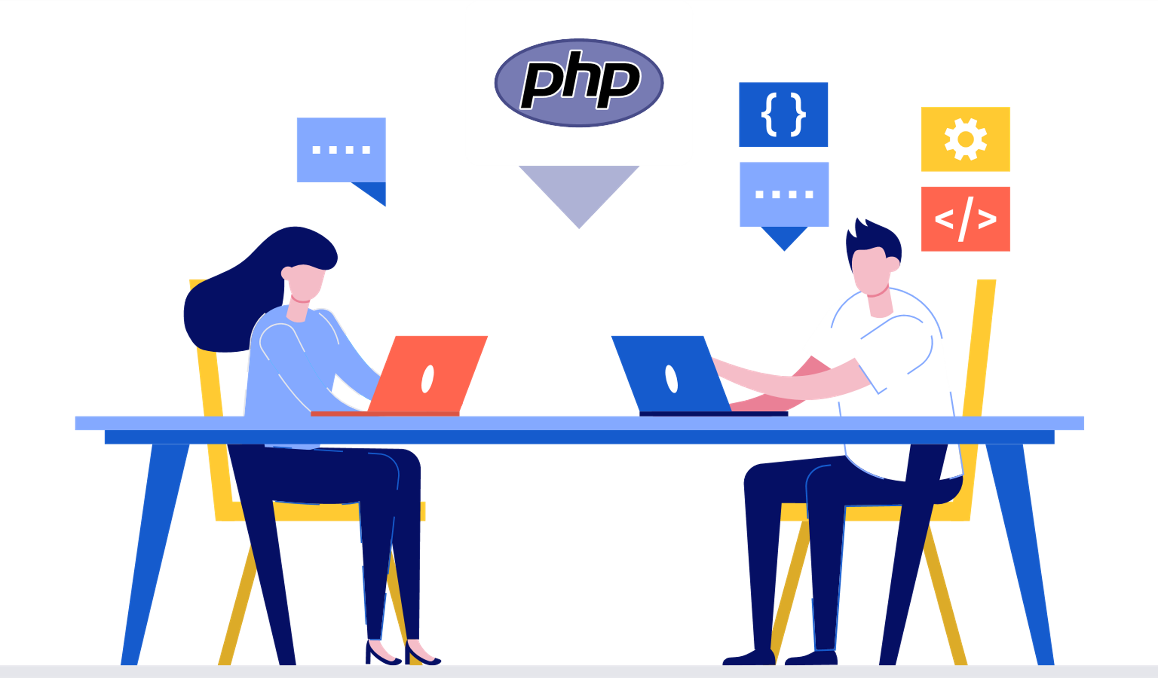
Hire Dedicated PHP Developers
- A Detailed Guide

Slide 2


PHP has become one of the most widely used scripting languages. Currently, PHP powers 78.1% of all websites; there’s no doubt that many businesses are shifting to PHP development and looking to hire dedicated PHP developers to work on their projects.
Source : https://www.weblineglobal.com/blog/hire-dedicated-php-developers-guide/

Slide 3
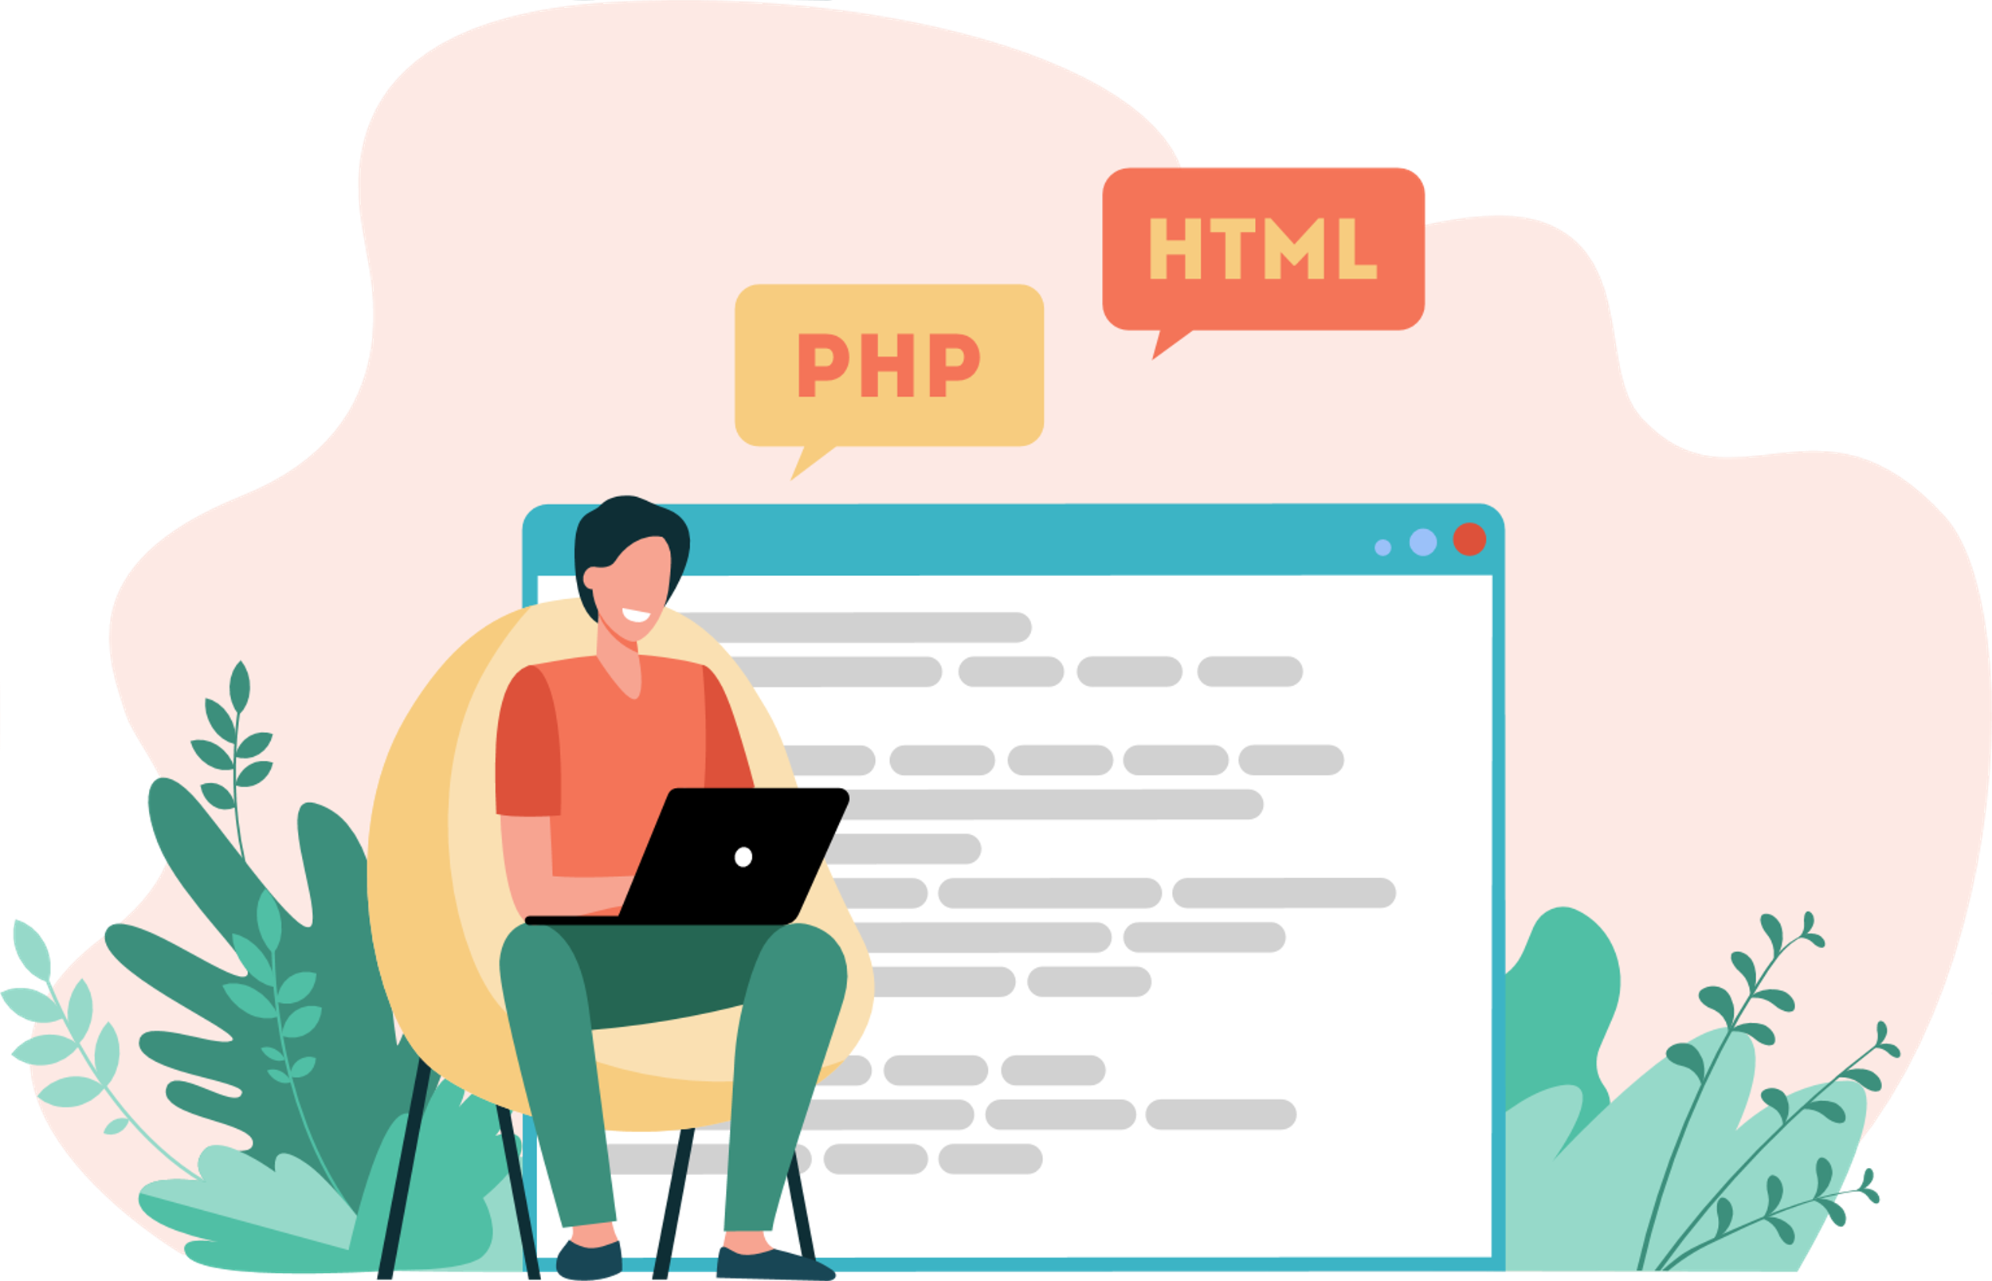
Who is a PHP developer?
PHP developers are web developers who use a
dynamic scripting language, such as PHP, to create, test and maintain code for websites, applications, and apps.
Source : https://www.weblineglobal.com/blog/hire-dedicated-php-developers-guide/

Slide 4
Dedicated PHP developer Duties and Responsibilities
Addressing compatibility issues with various software programs, platforms, and browsers.
Introducing new features to the projects that are appropriate to the project requirements.
Meeting all the deadlines during the project’s development and implementation.
Participating in a collaborative endeavour with all stakeholders and team members.
Monitoring and updating the information regularly.
Source : https://www.weblineglobal.com/blog/hire-dedicated-php-developers-guide/

Slide 5

Below are a few reasons to hire PHP experts
PHP is Quick
Software created with PHP loads quickly. This is because PHP-developed software products run through their own memory, which increases the product’s loading speed.
It is Feasible
Not only PHP can run on any standard server, but it can also be used for a variety of different purposes. If you are looking for PHP developers for hire then it would allow for server-side scripting as well as comprehensive software development.
Source : https://www.weblineglobal.com/blog/hire-dedicated-php-developers-guide/

Slide 6


Below are a few reasons to hire PHP experts
Database Connectivity
The database connectivity of the PHP framework is incredible. It can connect to numerous database servers, the most common among which is MySQL, which can be used for free with PHP.
Cost-effective Execution
PHP’s cost-effective execution is one of its most useful features. As many PHP tools are open-source, the cost of working with PHP frameworks immediately decreases.
Source : https://www.weblineglobal.com/blog/hire-dedicated-php-developers-guide/

Slide 7


Below are a few reasons to hire PHP experts
High Supply of Resources
There are a lot of PHP and Laravel developers available. This includes PHP programmers who are highly qualified, experienced, and skilled. As a result, it is frequently easier to find PHP developers for hire.
Object-Oriented Nature
PHP releases after 5.0 introduced object-oriented functionality to the language. PHP can now support OOP ideas, making development much more efficient.
Source : https://www.weblineglobal.com/blog/hire-dedicated-php-developers-guide/

Slide 8
Hiring PHP Developers | A 4-Step Process
Categories
There are three types of PHP developers based on the talents required for the PHP project.
Expert: This is the category to look at if you require extensive industry experience. If you hire dedicated PHP developers with expertise, then they can systematically translate your ideas into powerful features.
Mid-Level: Mid-level PHP developers have previous industry experience and have worked on a few PHP solutions. In this category, you can hire a PHP expert to get quality at a cheaper cost.
Beginner: As the name implies, the beginner-level PHP developer is new to PHP development. This category is appropriate when you are looking for PHP developers for hire.
Source : https://www.weblineglobal.com/blog/hire-dedicated-php-developers-guide/

Slide 9
Hiring PHP Developers | A 4-Step Process
Drafting a List of Frameworks
There are numerous PHP frameworks. If you need to construct a software product quickly, raw PHP is a good framework to employ. Other frameworks like Laravel can be used if you need something scalable.
Establish Specific Goals
Once you’ve decided on a PHP framework, set clear and simple project goals. This will assist you to hire dedicated PHP developers required for project development.
Ensure Quality
The ultimate stage of this journey is to ensure development quality. It is critical to recognize that software development entails several cross-functional teams.
Source : https://www.weblineglobal.com/blog/hire-dedicated-php-developers-guide/

Slide 10

What are the Important Skills that a PHP developer must have?
Technical Skills
Developing a software product is entirely technical. Check the candidate’s knowledge of languages such as HTML, CSS, AJAX, JavaScript, MySQL, XML & others. If you hire PHP programmers, it will undoubtedly be beneficial in the long run.
PHP Frameworks
The development team should not only comprehend the basic PHP language but also understand additional PHP frameworks such as CakePHP, Laravel, Codeigniter framework, and so on.
Source : https://www.weblineglobal.com/blog/hire-dedicated-php-developers-guide/

Slide 11


What are the Important Skills that a PHP developer must have?
Communication Skills
You should hire PHP web developers with good communication skills. The developer should be able to comprehend your work instructions and successfully address any of their problems.
Web Designing Skills
If you have decided to hire PHP experts then they should be familiar with some web design principles, such as deciding the appearance and feel of the website.
Source : https://www.weblineglobal.com/blog/hire-dedicated-php-developers-guide/

Slide 12

What are the Important Skills that a PHP developer must have?
Swift Learner
The developer should be a quick learner with a strong desire to learn more, as well as have a strong passion. Hire PHP programmers who are willing to learn beyond their current skill set.
Source : https://www.weblineglobal.com/blog/hire-dedicated-php-developers-guide/

Slide 13
What Should You Know Before You Hire PHP Web Developers?
The Developer’s Role is Crucial
The Hiring Model Should be Predetermined
Past projects are an important factor to consider when evaluating a PHP developer’s expertise. Even if you choose a specialized PHP for business, previous projects might reveal a lot about their expertise.
There are two ways to hire PHP Developers:
Dedicated: The dedicated model is hourly based. If you hire PHP experts under this category, the cost is determined based on the number of hours spent on the project.
Fix-cost: A fixed cost underpins the fixed cost concept. The software development project requirements are absolutely clear and well-documented here.
Source : https://www.weblineglobal.com/blog/hire-dedicated-php-developers-guide/

Slide 14
What Should You Know Before You Hire PHP Web Developers?
Communication is Important
Adaptability for Improved Outcomes
To absorb information accurately and precisely, a developer should have good communication skills. Moreover, the PHP developers available for hire with the outsourcing company should be familiar with the language that you prefer as a mode of communication.
A PHP developer should have an open mind & appropriate reasoning abilities for your project. They should be able to withstand the stress of tight deadlines, overflowing deadlines & overwhelming project conditions.
Source : https://www.weblineglobal.com/blog/hire-dedicated-php-developers-guide/

Slide 15


Hiring a Dedicated PHP Developer | Top Benefits
Cost Saving
It is far more cost-effective to engage a PHP Development company. You can save money
when you hire PHP Developer for a specific assignment as per the requirements.
Deadline Description
Because of their knowledge & mastery of PHP language, dedicated PHP developers work well to assure project submission is on time. This dedicated developer’s team can tackle any complex issue that arises throughout the given timetable.
Source : https://www.weblineglobal.com/blog/hire-dedicated-php-developers-guide/

Slide 16


Hiring a Dedicated PHP Developer | Top Benefits
Flexibility
If you hire PHP programmers it would eliminate the need of setting up premises or infrastructure for the development team and provides considerably more flexibility.
Speed to Market
High-quality web programs & apps are created by devoted experienced PHP coders, resulting in better business resilience, upgraded, and improved ability to function more efficiently to meet your end goal.
Source : https://www.weblineglobal.com/blog/hire-dedicated-php-developers-guide/

Slide 17
How Much Does Hiring a PHP Developer Cost?
The cost to hire PHP web developers may vary depending on the resource you utilize. For example, Freelancing developers typically set their fixed charges. Yet, it is unlikely to deviate significantly from the typical cost for PHP engineers. Yet, due to economic factors, the charges are frequently substantially cheaper when you outsource.
Where can you get the Most Skilled PHP Developers?
Most businesses hire dedicated PHP developers to ensure quick project delivery. If you’re concerned about choosing a PHP Development Company that wouldn’t compromise on the quality of your project, consider WeblineGlobal.
Source : https://www.weblineglobal.com/blog/hire-dedicated-php-developers-guide/

Slide 18
Conclusion
If you want to create a dynamic website to help your business, PHP can be the programming language for you. You can hire dedicated PHP developers to help you with your next software project in various areas. WeblineGlobal is an outsourcing company that offers to collaborate closely with you to ensure that all your needs are addressed.
Source : https://www.weblineglobal.com/blog/hire-dedicated-php-developers-guide/

Slide 19

Thank You
CONTACT US
+1-213-908-1090 (USA)
+61-2-8011-4668 (AUS)
+44-207-193-7507 (UK)
+91-79-26420897 (IND)
EMAIL
info@weblineglobal.com
WEBSITE
www.weblineglobal.com

